Slide 1

Abundantly More Charts Assignment
David Berberena
DSC 640 Data Presentation and Visualization
Weeks 7 and 8
7/28/24

Slide 2
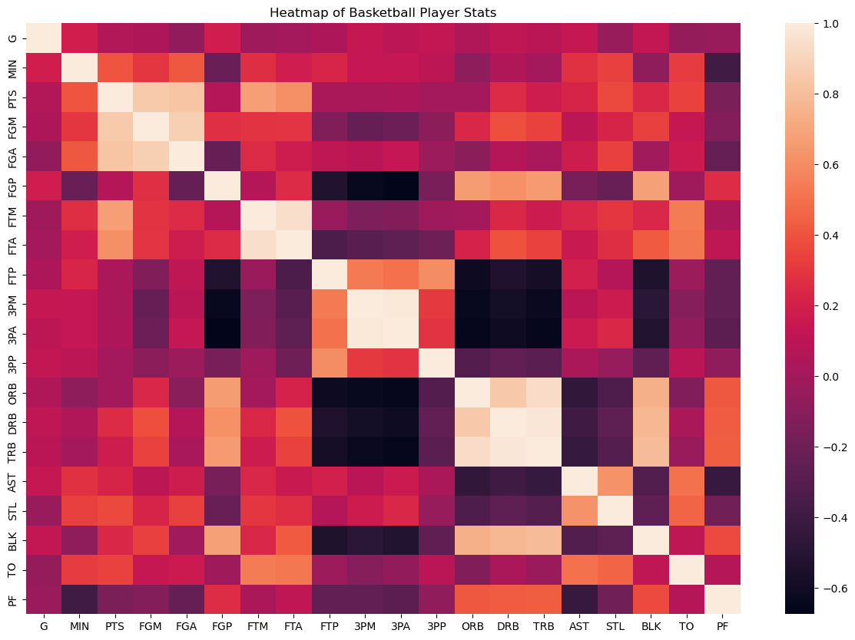
Python Heatmap

Slide 3
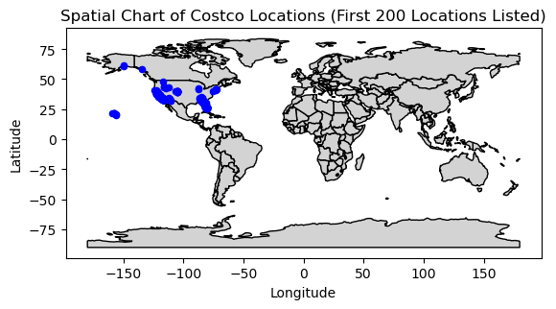
Python Spatial Chart

Slide 4
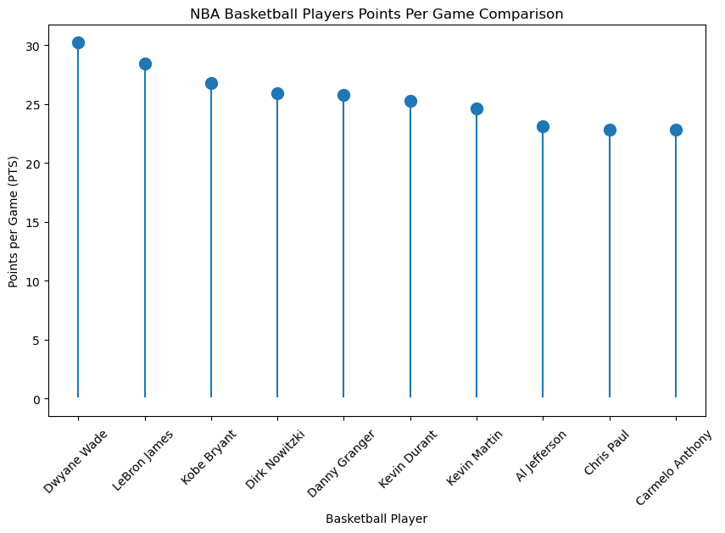
Python Lollipop Chart

Slide 5
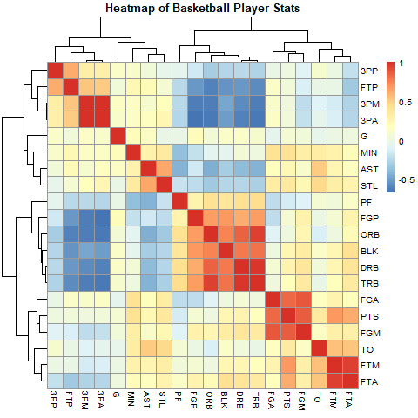
R Heatmap

Slide 6
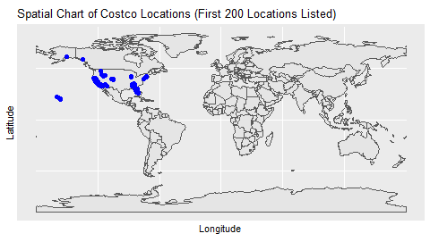
R Spatial Chart

Slide 7
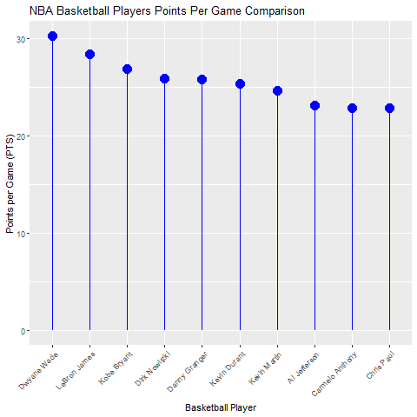
R Lollipop Chart

Slide 8
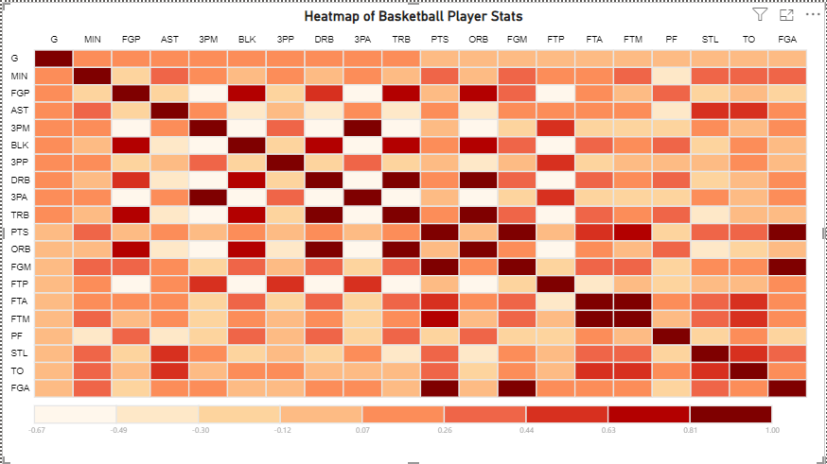
PowerBI Heatmap

Slide 9
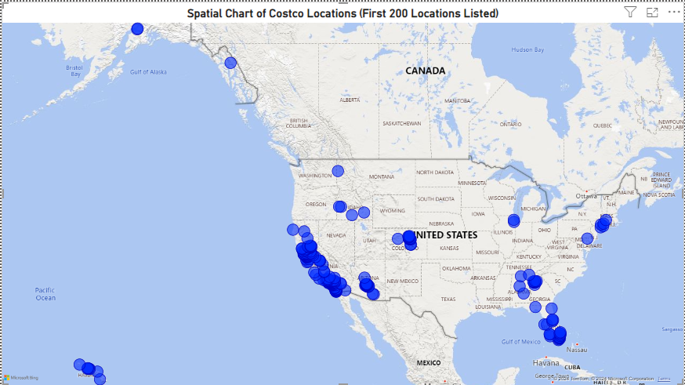
PowerBI Spatial Chart

Slide 10
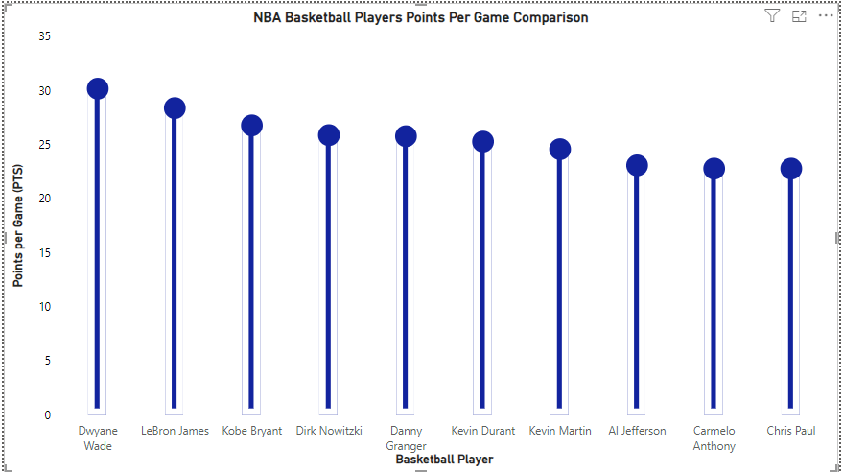
PowerBI Lollipop Chart

